Slide 1
Department of Computer Science & Engineering
UE17CS355 – Web Tech II
Project Evaluation
Project Title : Video game commerce and cataloguing website
Project Team :
PES1201700200 – Sudhanva S
PES1201701130 – Kartikeya J
PES1201701604 – Ajeya BS

Slide 2
Project Description
The project centers around making an e-catalogue website centered around video games.
With this website, we have a collection of games from several genres, platforms, age-groups, developers and so on.
We also have a display system where the user can read more information about the game and check it’s ratings, price, description and much more.
The intelligent functionality in our project involves graphs and statistics for the data we have, as well as an automatic emailing system.

Slide 3
Technologies Used
The main technologies used in this project are as follows:
Front-end: Made using Angular 9
Back-end: Made using Node-Express
Intelligent functionality: Web Scraping, Various python libraries like Pandas, Chart.js, Nodemailer

Slide 4
Techniques Implemented
REST API :
Used in the following pages:
Descriptions
Cart
Contact Us
Request for new graphs
Design Patterns used:
Periodic Refresh:
Used in the following pages:
Cart
Home
Multistage Download:
Used in the page
All Games

Slide 5
Intelligent Functionality
There are 2 intelligent functions:
Statistical analysis and exploratory data visualisation with Chart.js and web scraping
Got data using Web Scraping
Cleaned and analysed the data
Did analysis and visualisation using Chart.js
6 most relevant graphs are plotted
Automatic email sending to user about details with Nodemailer
Using nodemailer, as soon as the user clicks on buttons with respect to confirmations, a mail is sent to the user regarding the transaction
This is done using gmail’s smtp port and the admin’s auth and password.

Slide 6

Home page

Slide 7
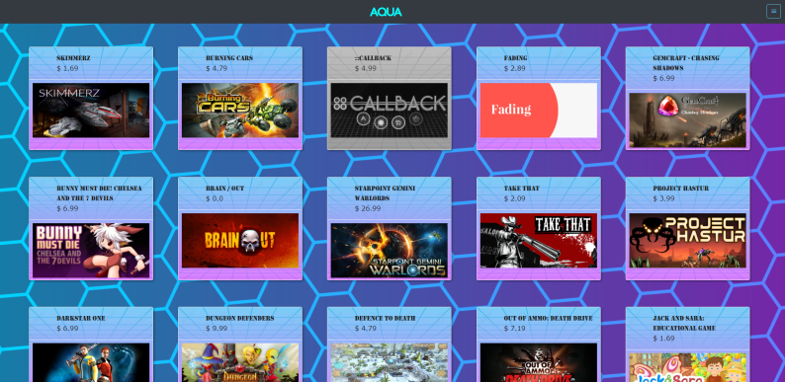
All Games Page

Slide 8
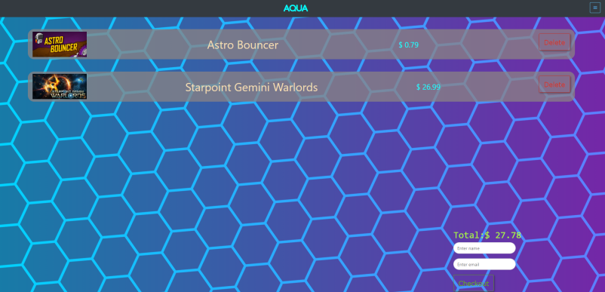
Cart Page

Slide 9
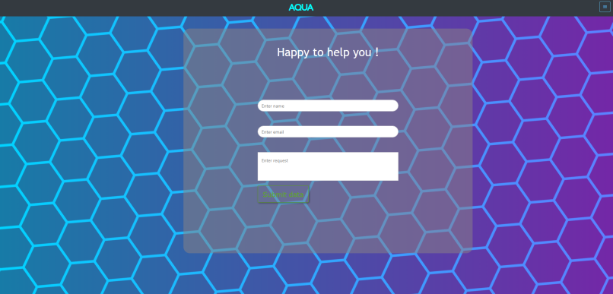
Contact Us Page

Slide 10
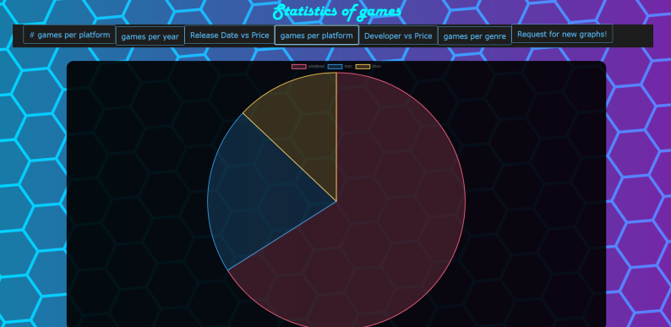
Statistics with one of the 6 graphs on display

Slide 11
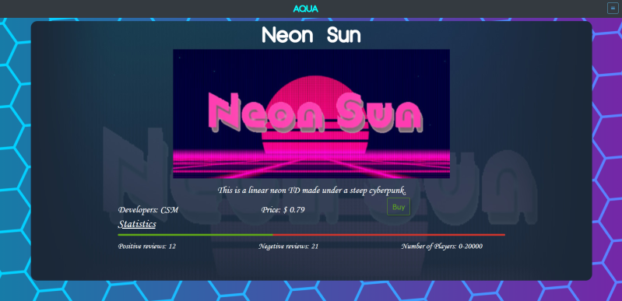
Description Page

Slide 12
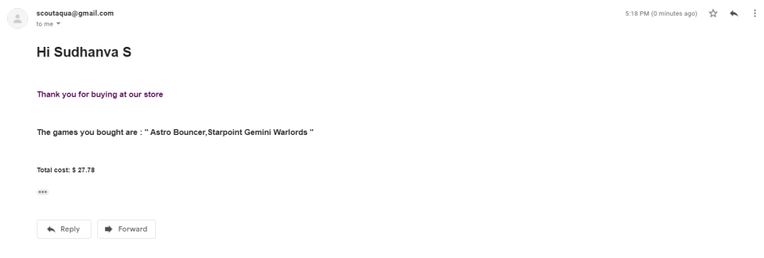
Mail confirmation upon completion of transaction

Slide 13
Thank You

